Slide 1
Improved Tensiometer system Systems analysis and design
Revolution Nine
Zhen Xu, Liuhuan Zhang, Gavin Haar

Slide 2
Areas of improvement
System accuracy and precision
Ease of use
Reduced setup time

Slide 3
Our improvements to the design
Electric motor to apply force to material
App to control motor
Provide user instructions via display screen
Upgraded clamps for material
‘Smoothing’ code for improved quality of stress-strain curve

Slide 4
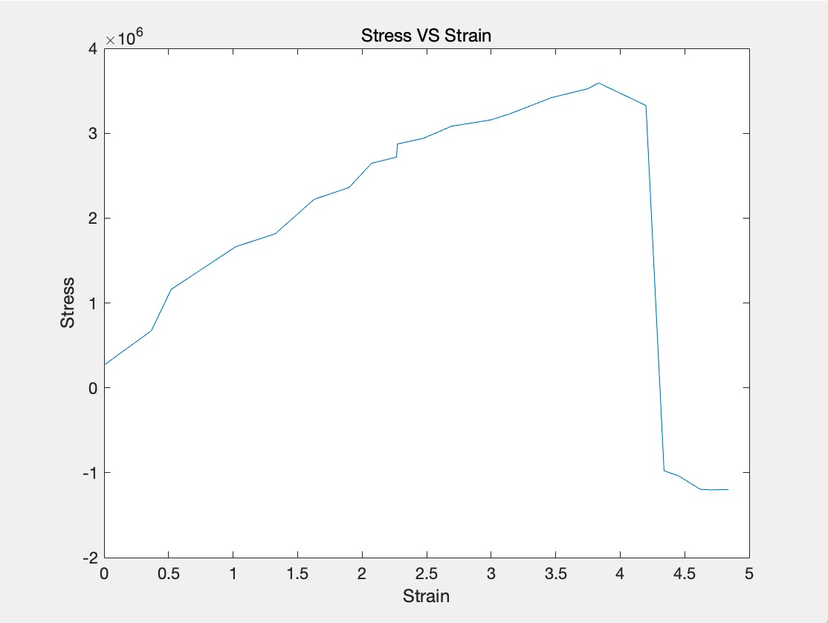
Smoothing graph
What’s changed?
Improved Arduino code and using MATLAB
Additional components

Slide 5
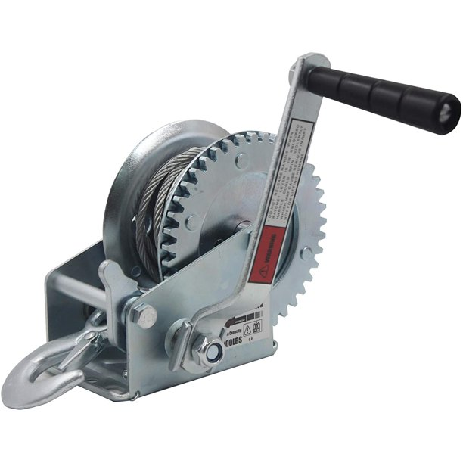
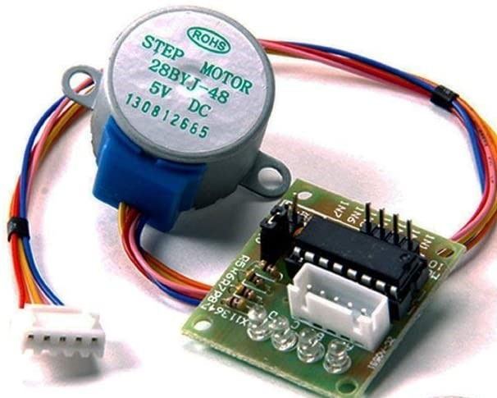
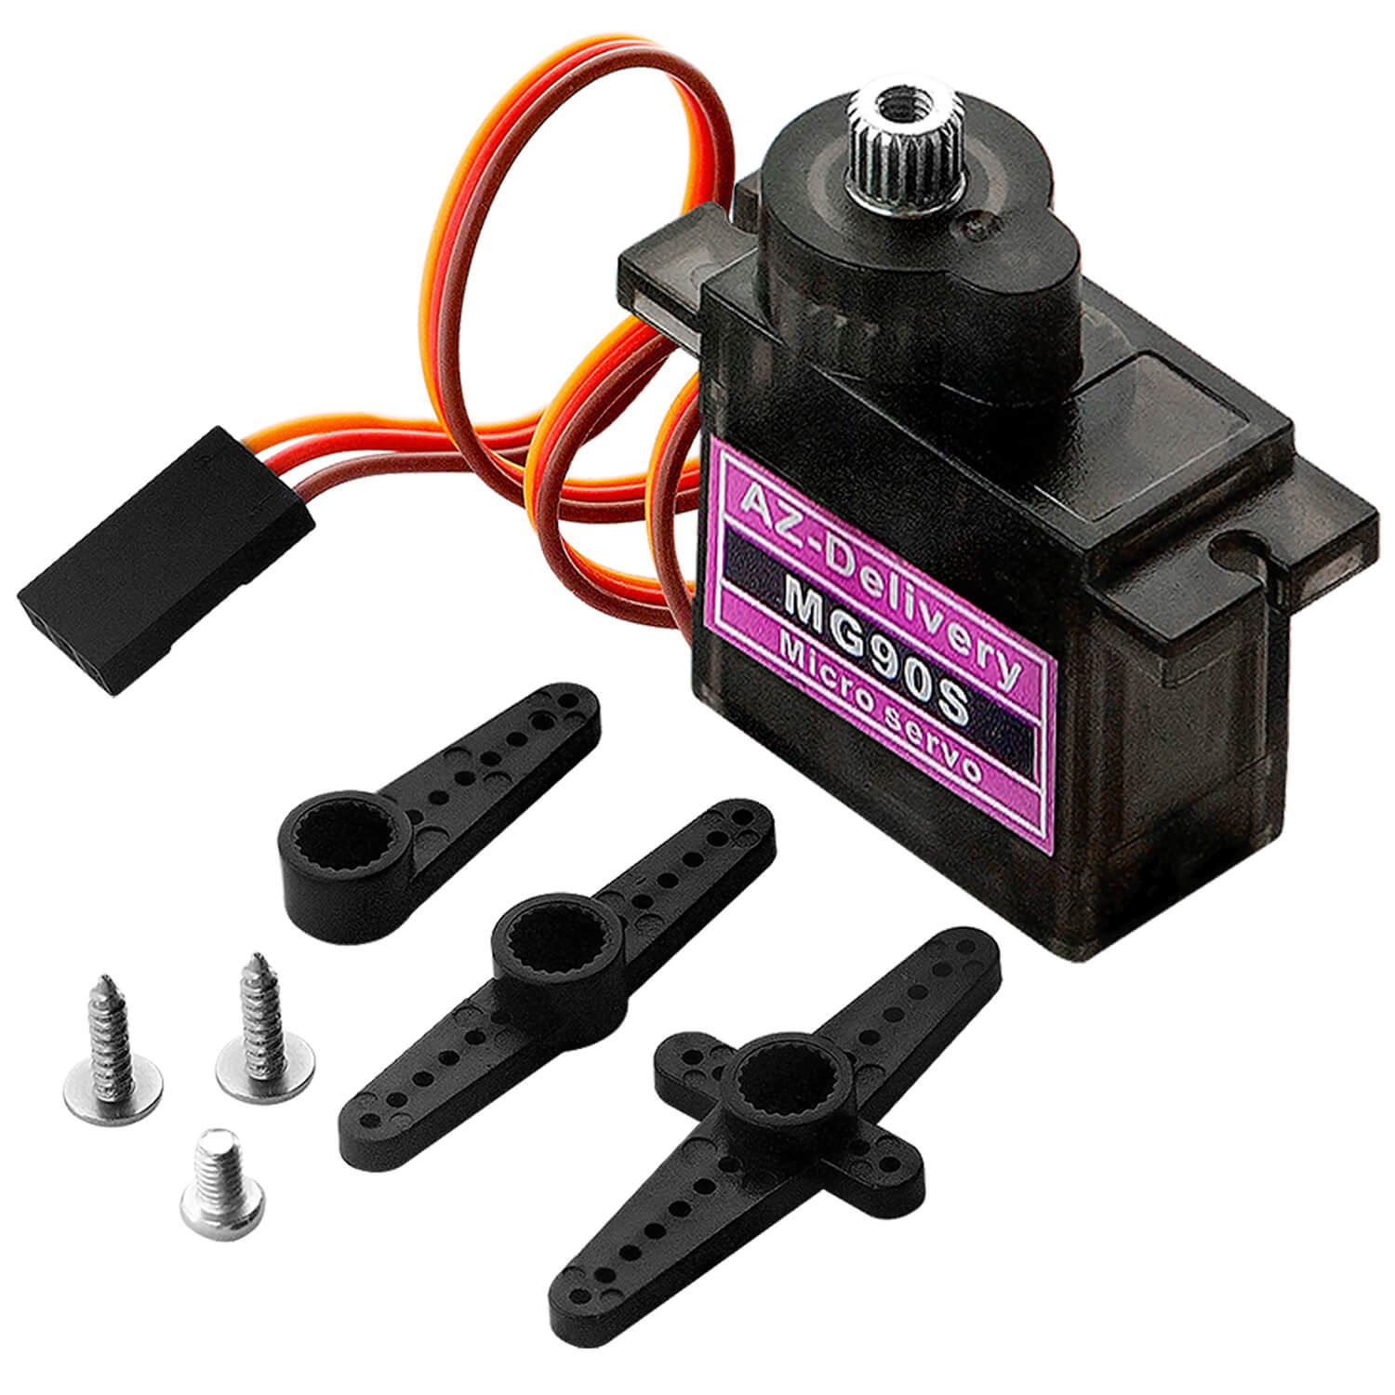




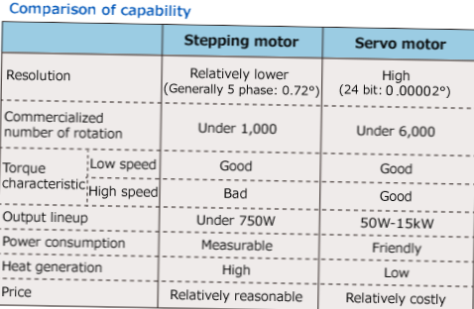

Slide 6
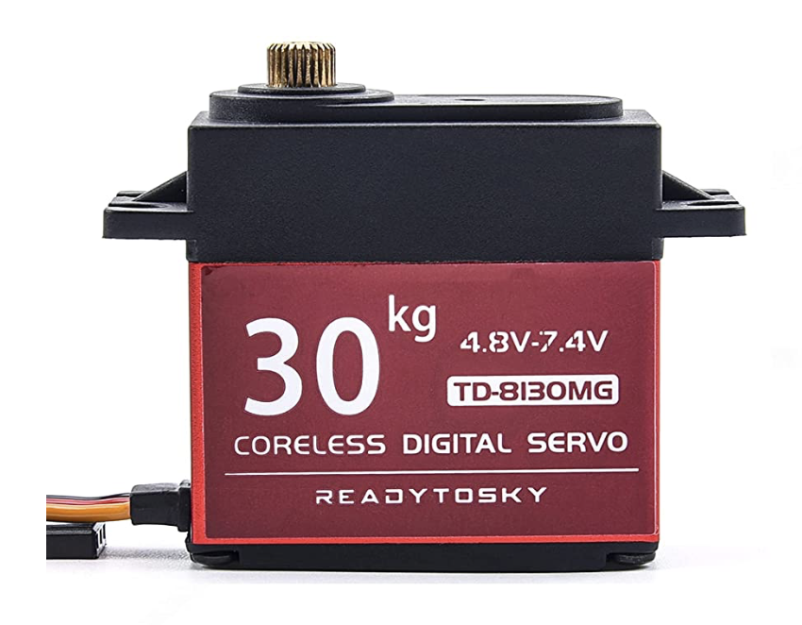
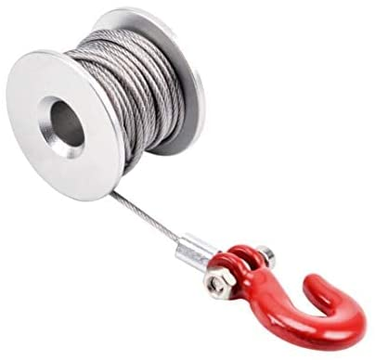
Servo Motor
Readytosky Digital 30KG Servo
Control pulling rope with app on cell phone
Consistent results
Metal gear
Steering gear winch

Slide 7
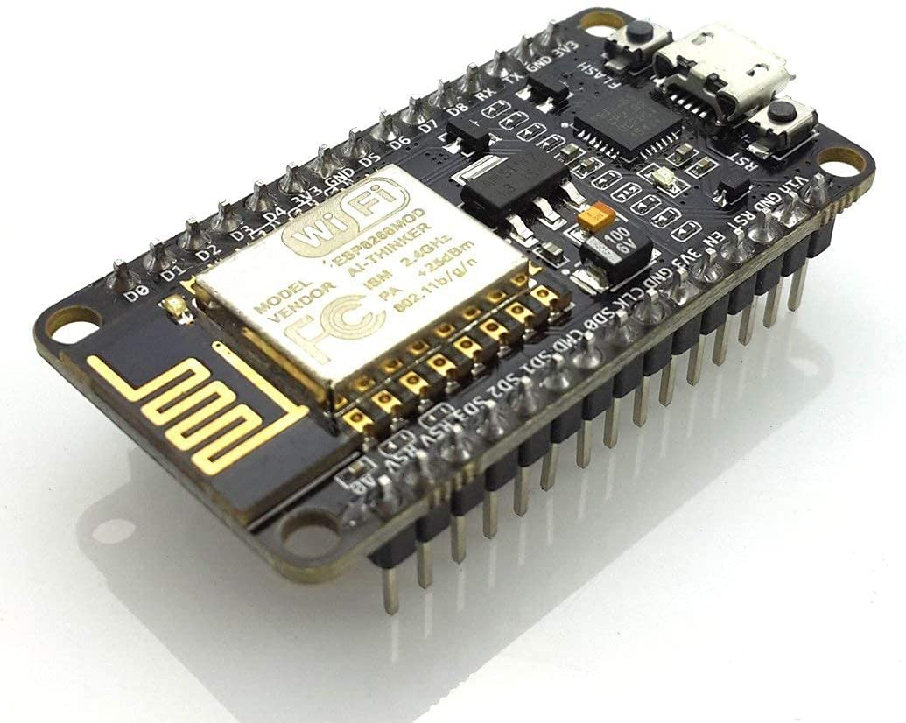
Wifi connected motor
HiLetgo 1PC ESP8266
Used to connect to app downloaded on cell phone
App name: Blynk

Slide 8
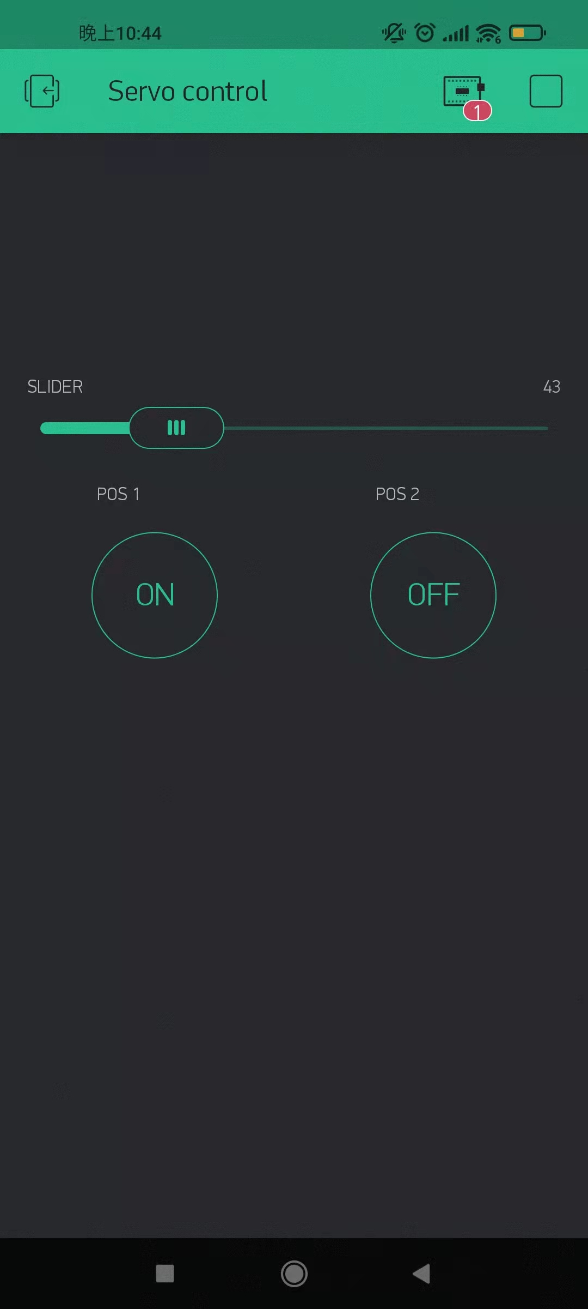
Blynk
Connect with ESP8266
Bar control motor Foreword or rollback
Also, bar could control speed of the motor

Slide 9
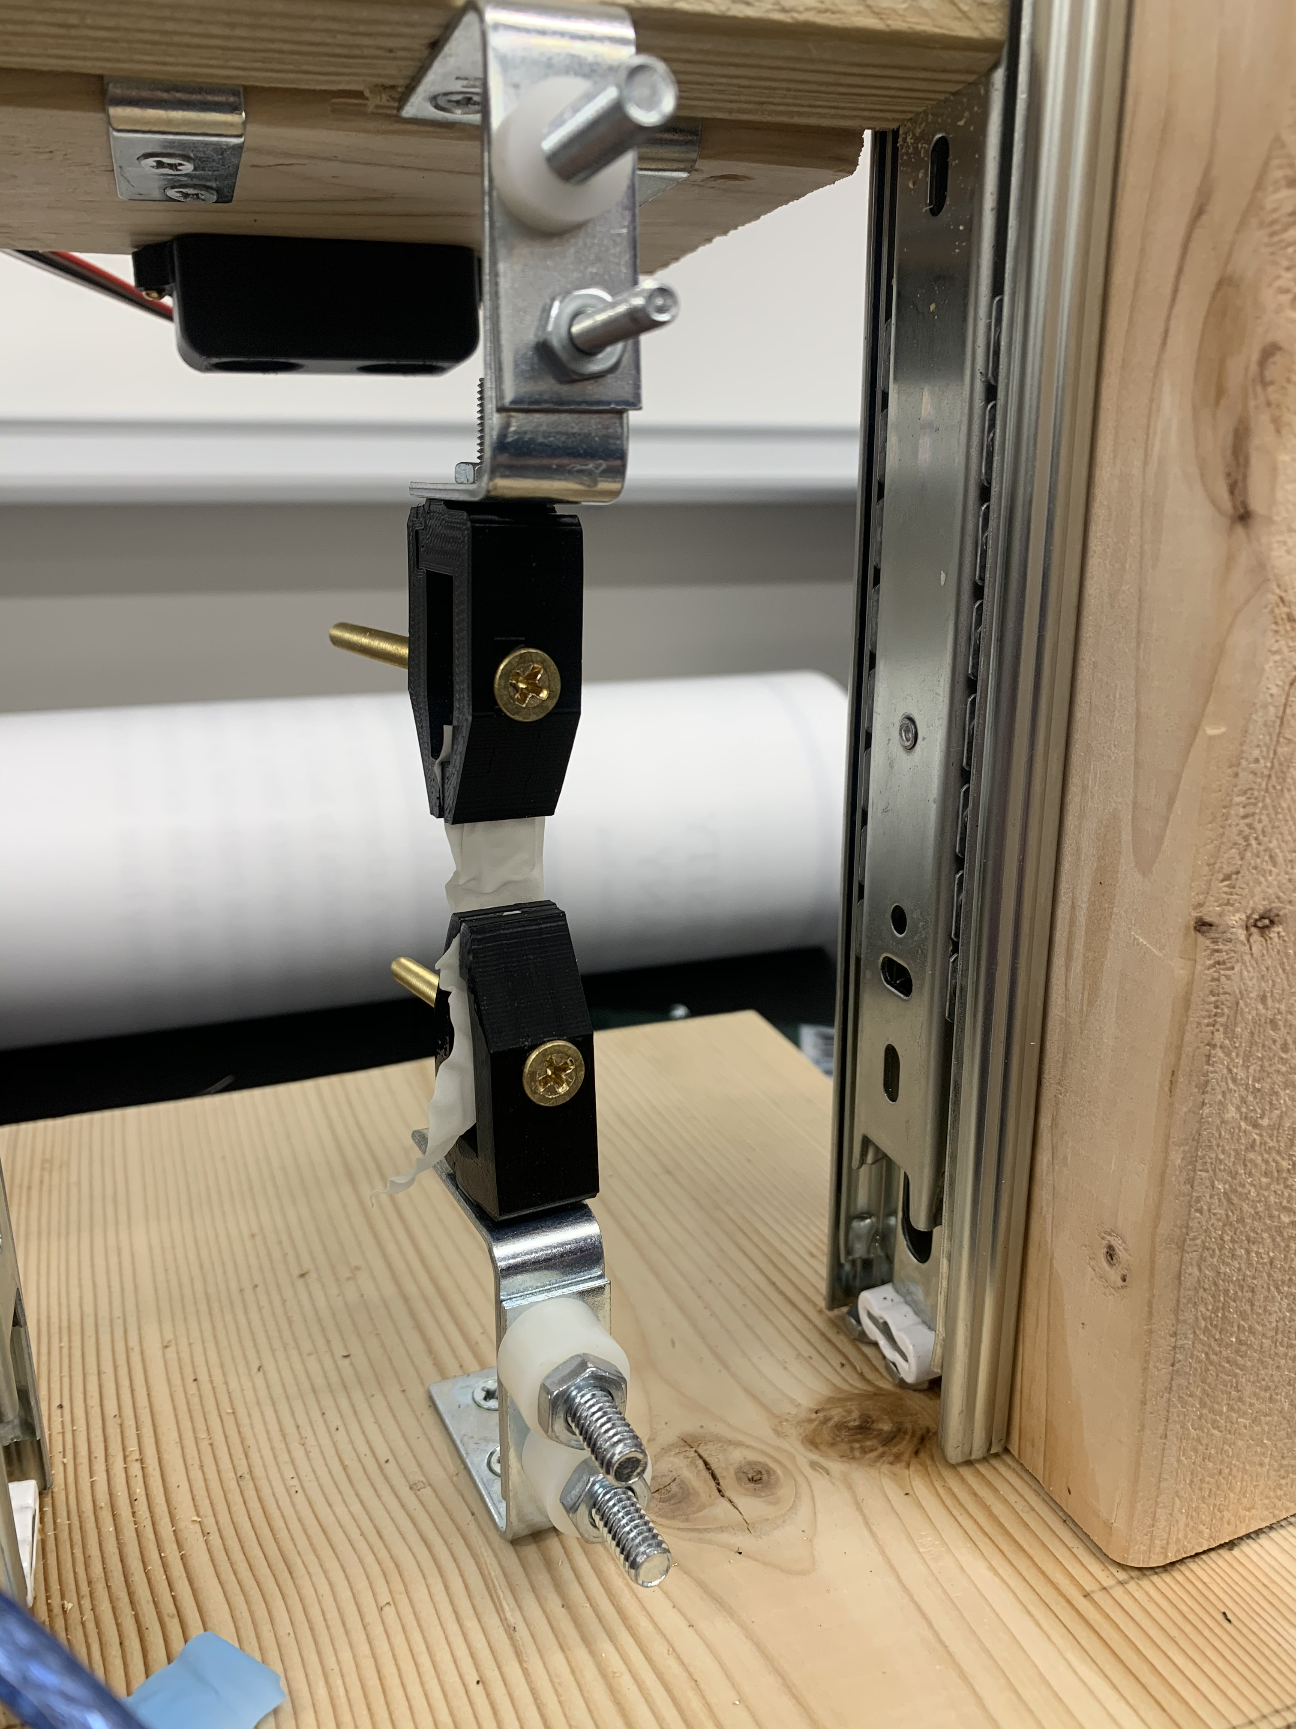
Upgraded clamps
Significantly reduced time to secure material
More reliable than original clamps
Created with 3D printer
Used application: TinkerCad & PrusaSlicer

Slide 10
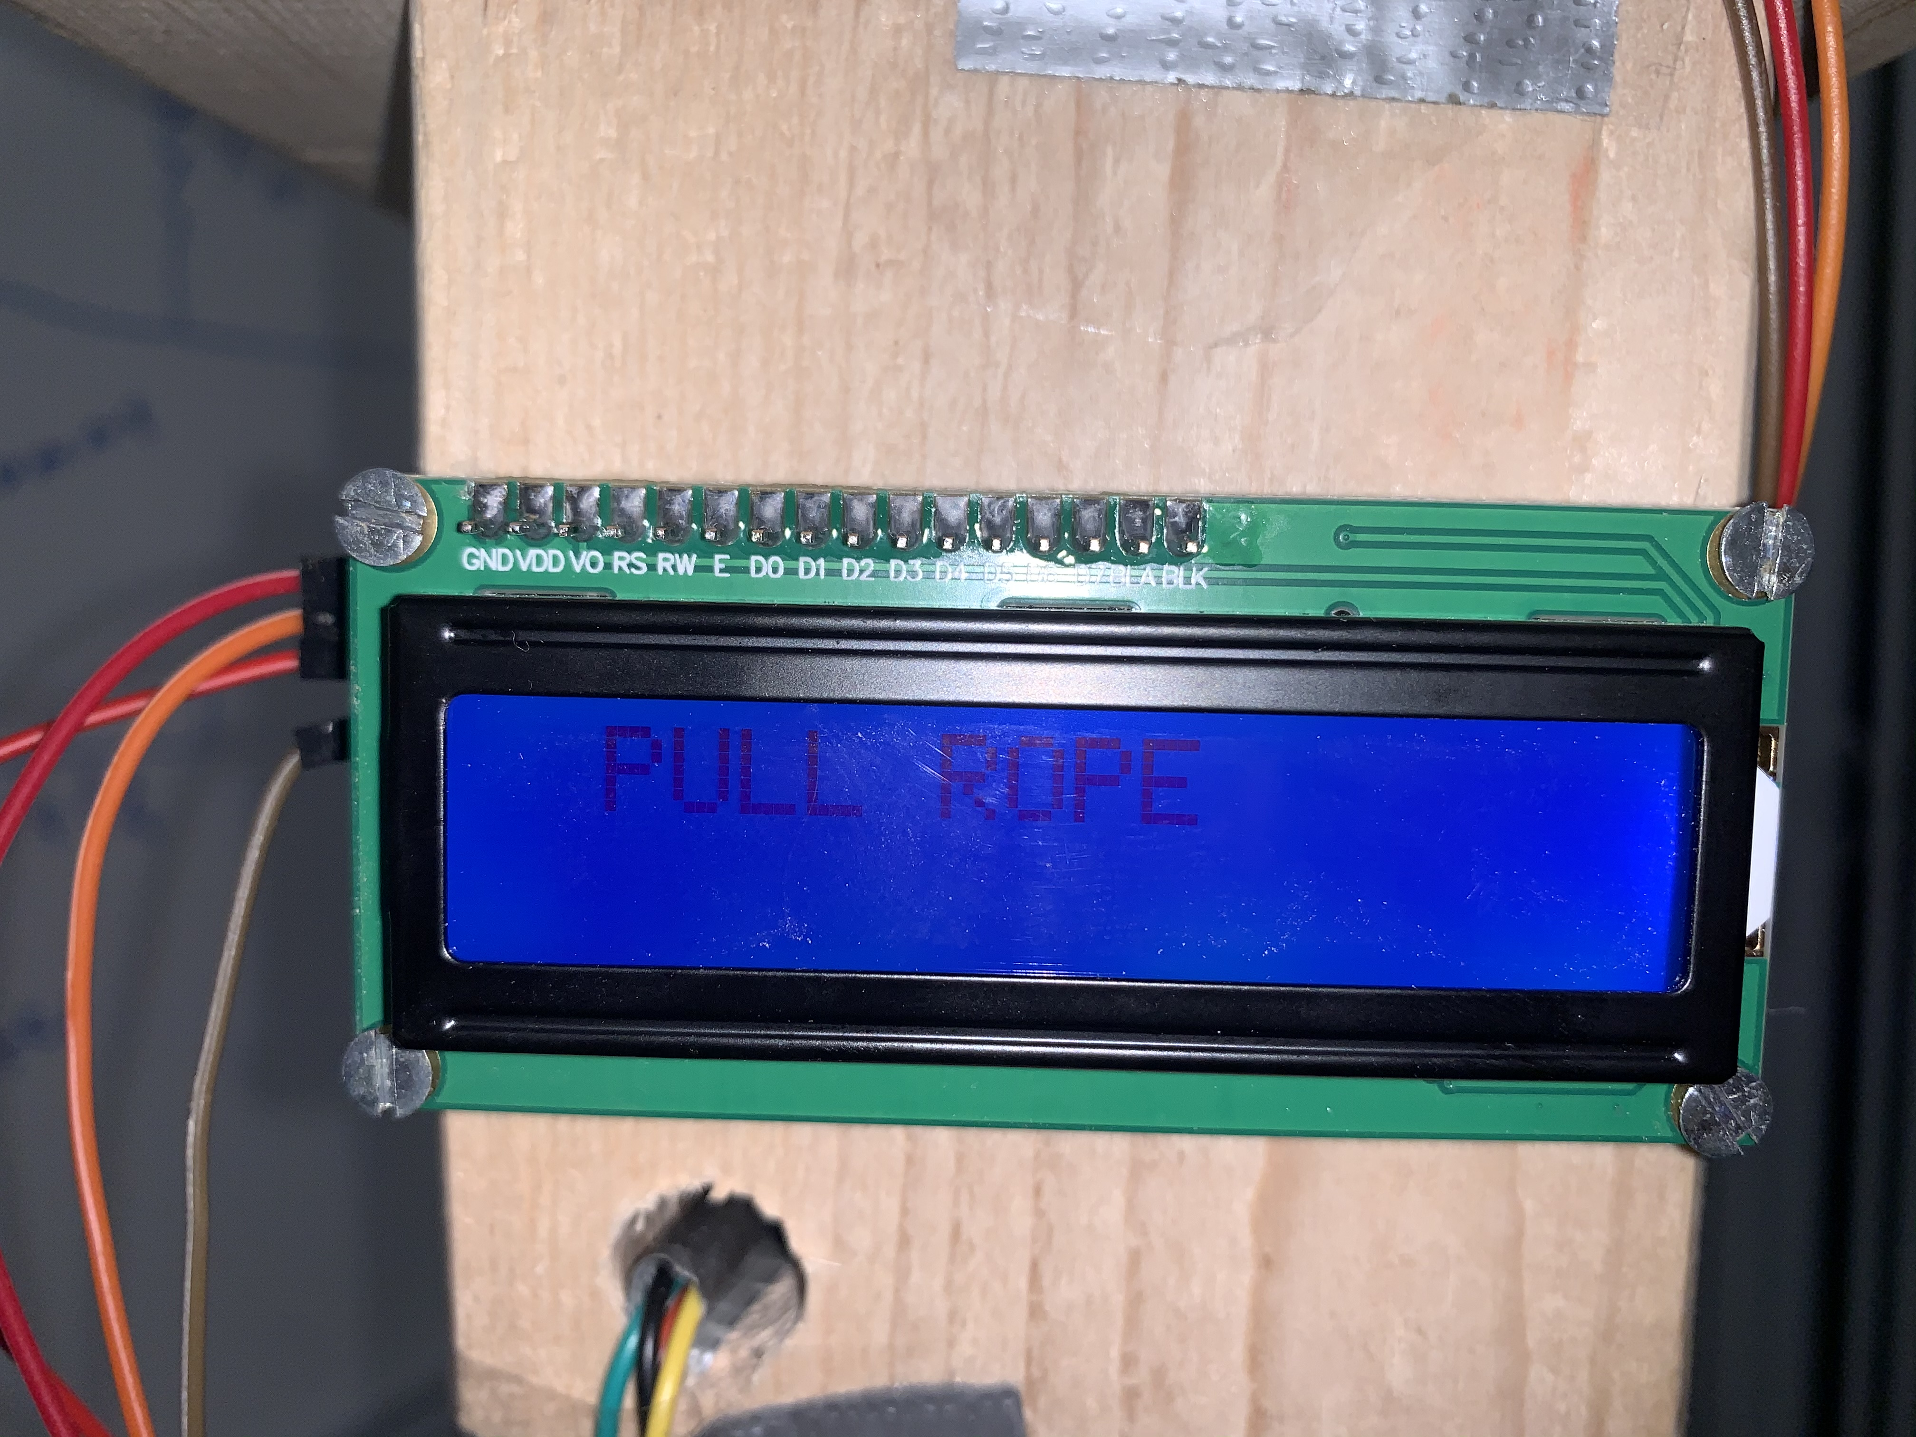
LCD screen
Instruct user on setup steps
I2C setup

Slide 11

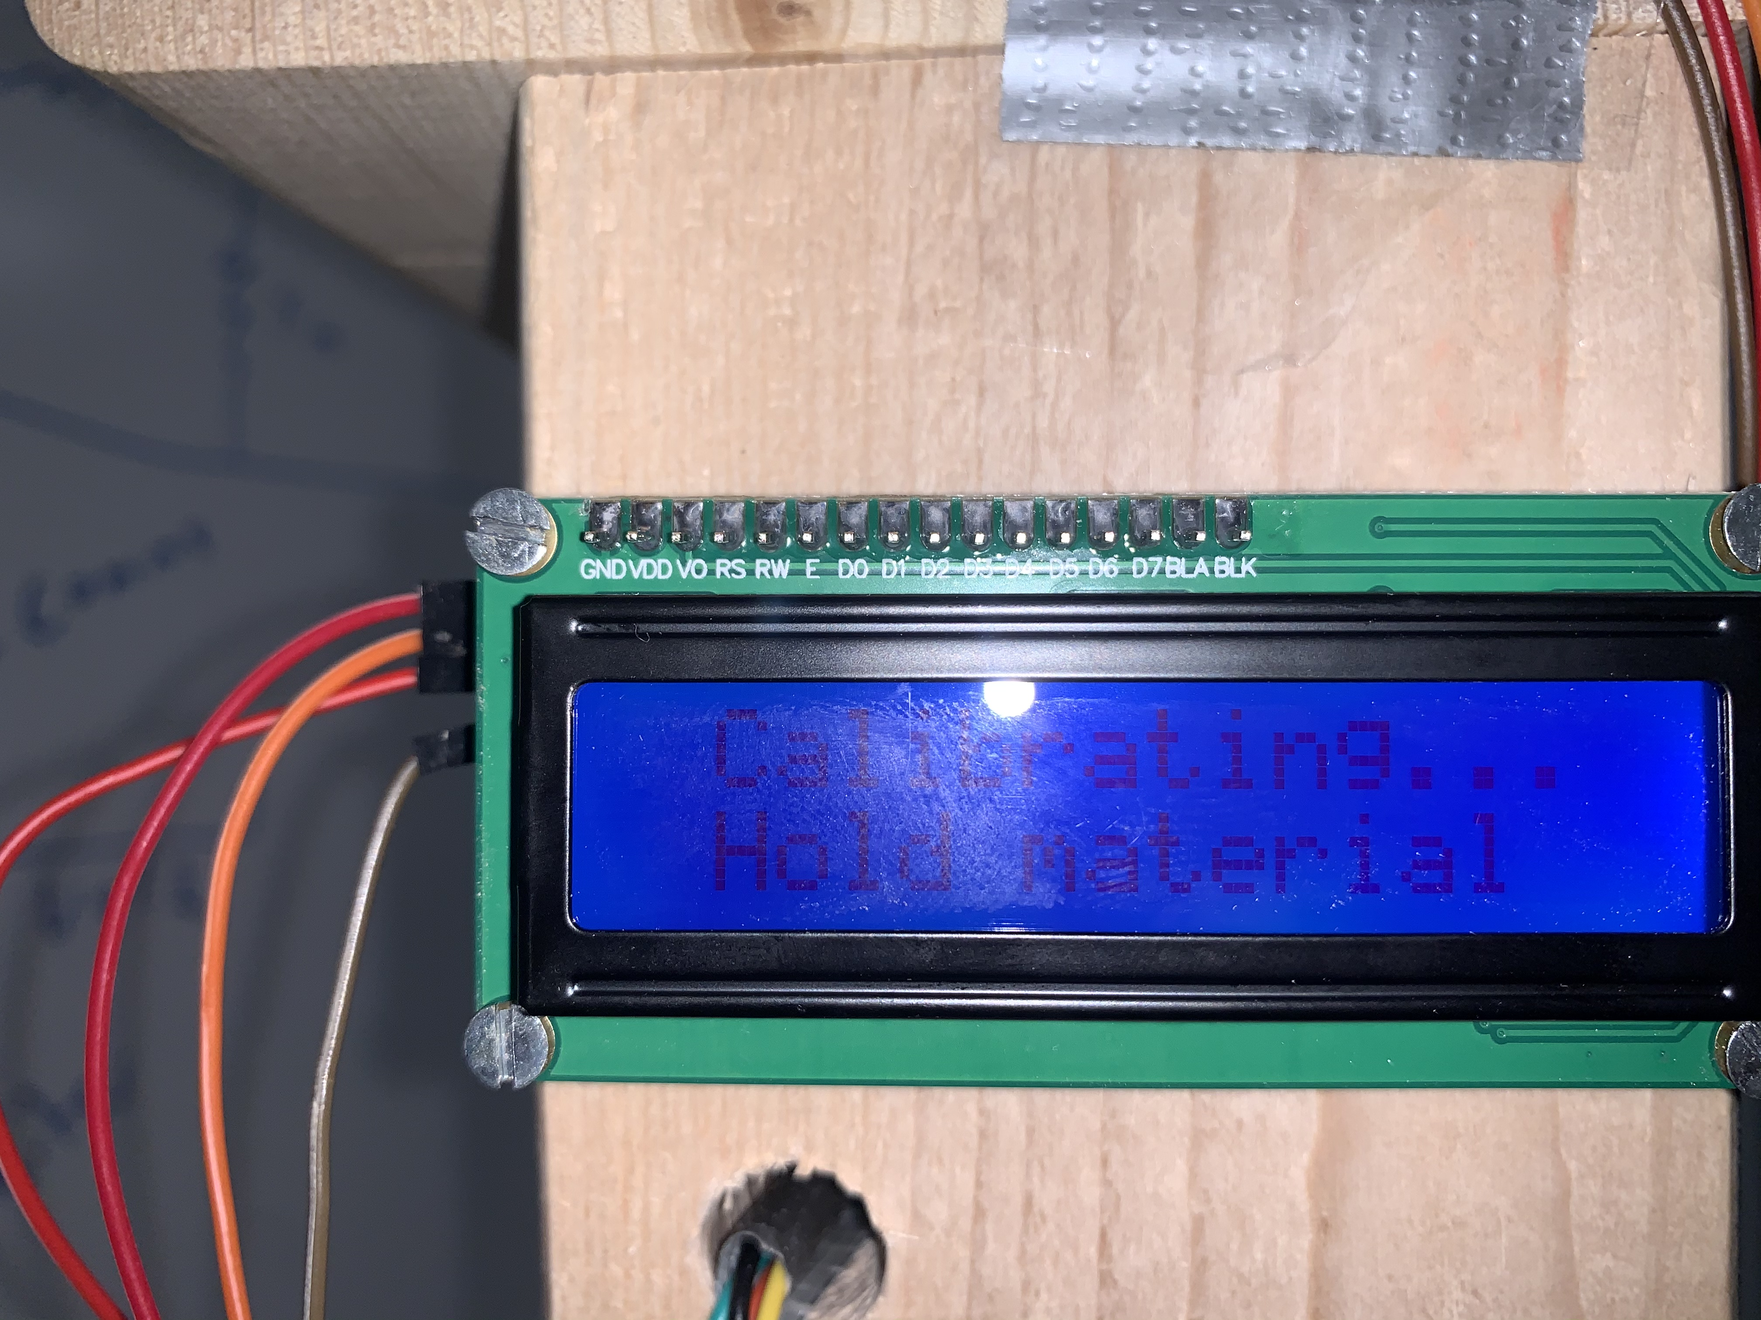
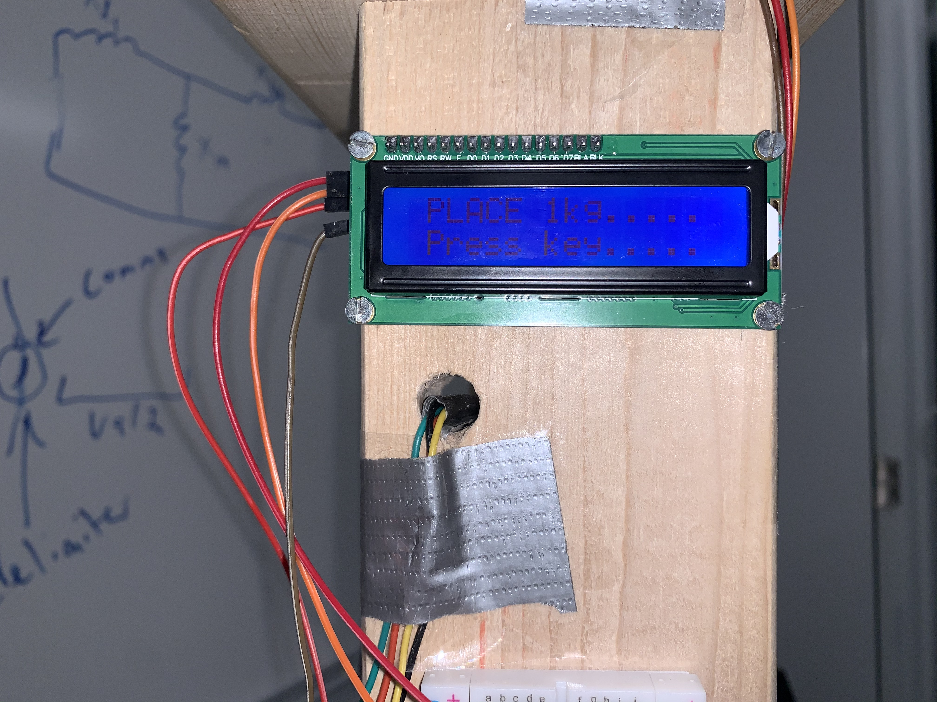
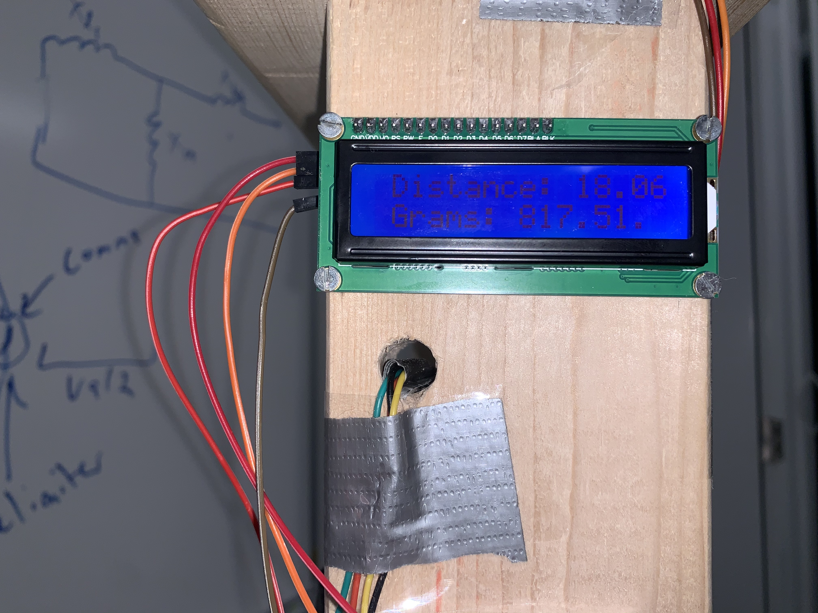
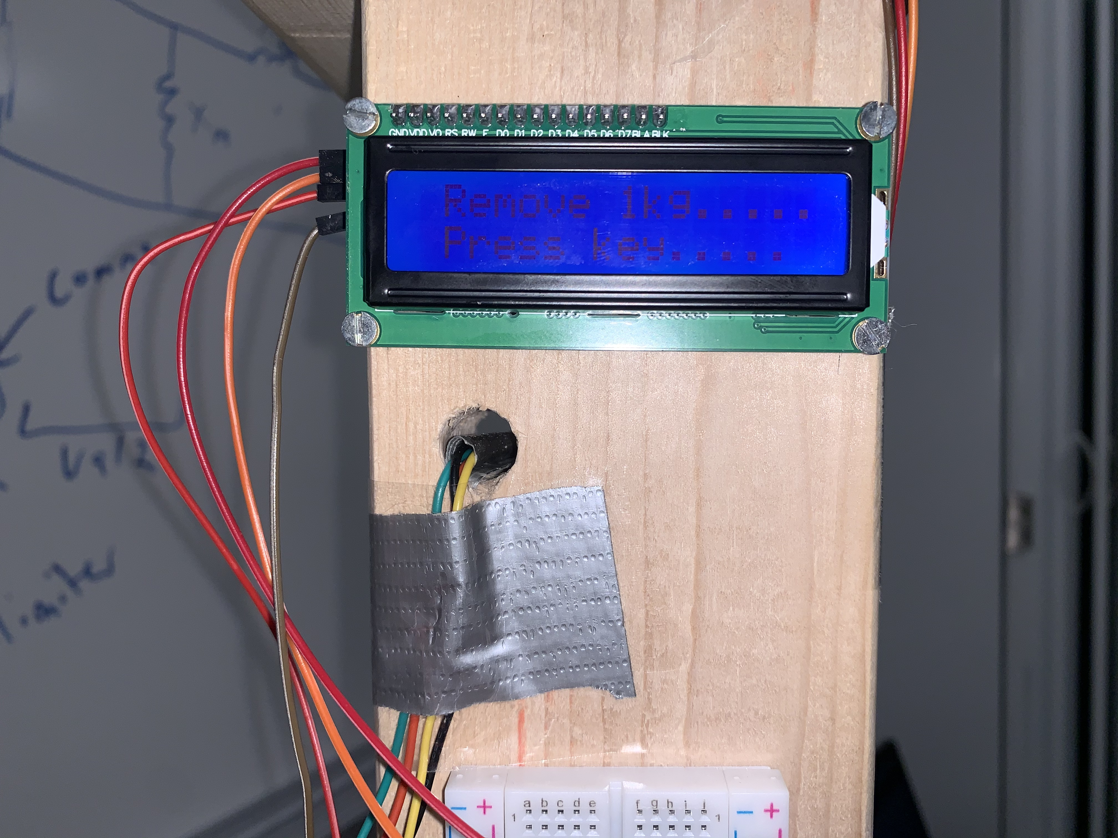
Calibration

Slide 12
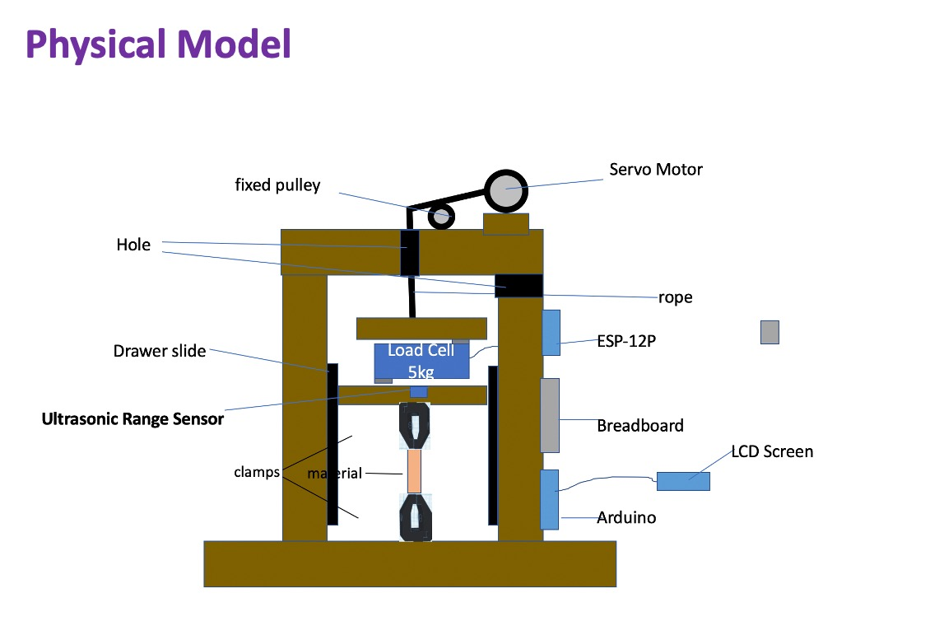
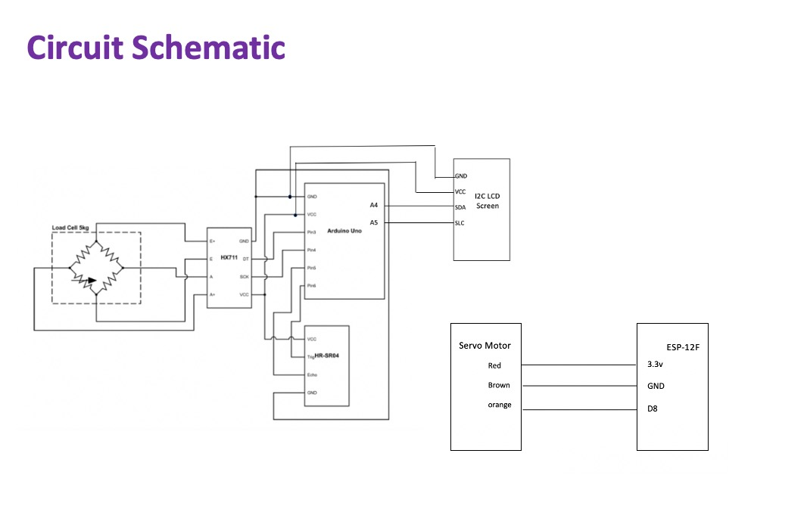
Design

Slide 13
Cost
Part | Purpose | Price
Cable | Pull Material | $9
LCD Screen | Display Information | $6
ESP-12P | Control Motor | $9
Servo Motor | Pull Material | $24
others | Fixed pully and screw | $5.5
 | Total | $53.5

Slide 14

devices “talk” to other devices without human interaction
Extensibility
Functional& cheap

Slide 15
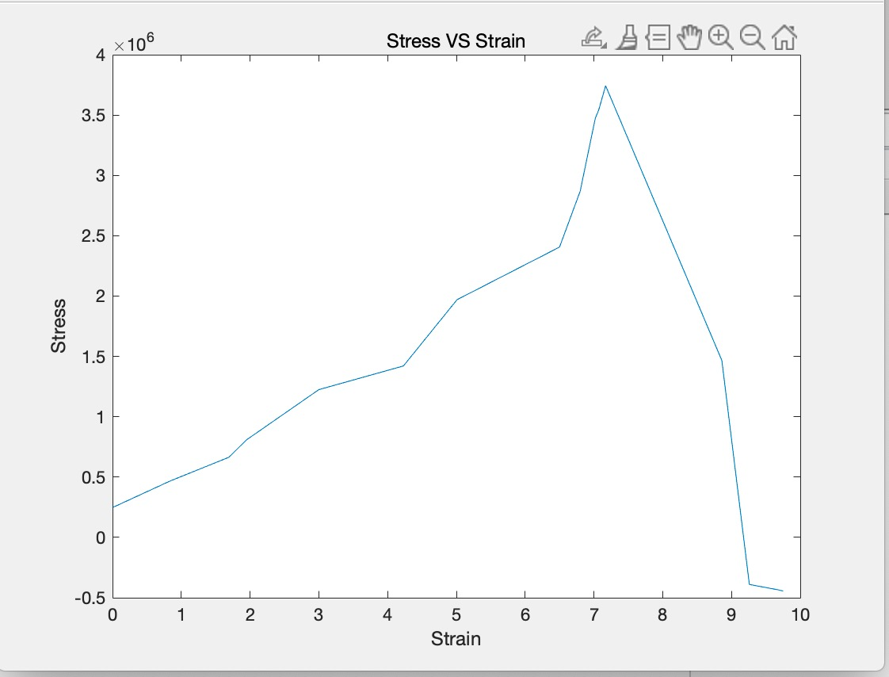
ResuLts
Latex
Nitrile

Slide 16
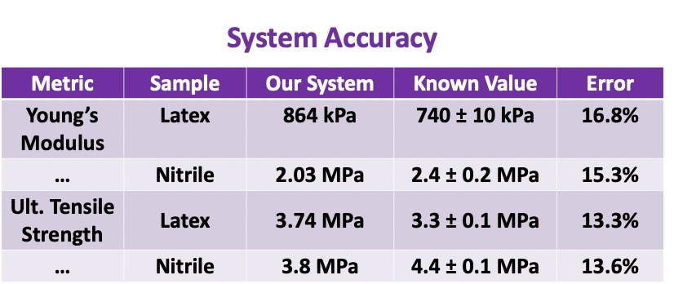
Results
Significant improvement from original system design

Slide 17
Thank you

